Slide 1
Multiclass Fish Image Classification

Slide 2
Problem Statement
Classify fish images into multiple categories.
Train a CNN model from scratch.
Use transfer learning with pre-trained models.
Save trained models for later use.
Deploy a Streamlit app for prediction from user-uploaded images.

Slide 3
Project Objectives
Build an efficient image classification system.
Compare custom CNN and transfer learning models.
Achieve high accuracy and generalization.
Provide a user-friendly prediction interface.

Slide 4
Methodology
Data preprocessing and augmentation.
Training CNN from scratch.
Experiment with five pre-trained models (e.g., VGG16, ResNet50, Mobile Net, InceptionV3, EfficientNetB0).
Fine‑tuning transfer learning models.
Compare metrics such as accuracy, precision, recall, F1-score, and confusion matrix across all models.
Saving models and deploying with Streamlit.

Slide 5
Tools and Technologies
Python (Pandas, NumPy, Tensorflow and Matplotlib)
Streamlit for interactive dashboard.
For training, evaluation, and deployment -Experiment with five pre-trained models (e.g., VGG16, ResNet50, MobileNet, InceptionV3, EfficientNetB0).

Slide 6
Streamlit Deployment
User uploads an image through the UI.
Model loads the saved weights.
Predicted fish category and probability displayed.
Provide model confidence scores for each model.

Slide 7
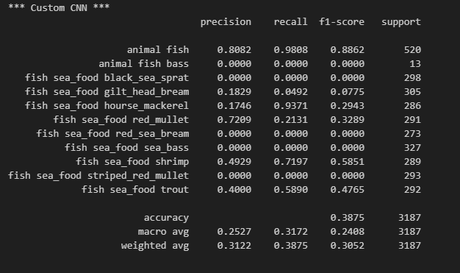

Slide 8
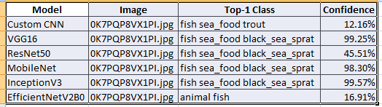

Slide 9
Conclusion
Determine the best model architecture for fish image classification.
Evaluate and compare metrics across models to select the most suitable approach for the task.

Slide 10
Thank You

